Slide 1
Wavelength
Mid-Way Presentation
Team 2: Connor, Corbin, Sebastian, Steven

Slide 2

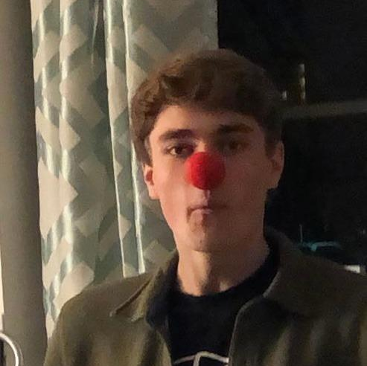
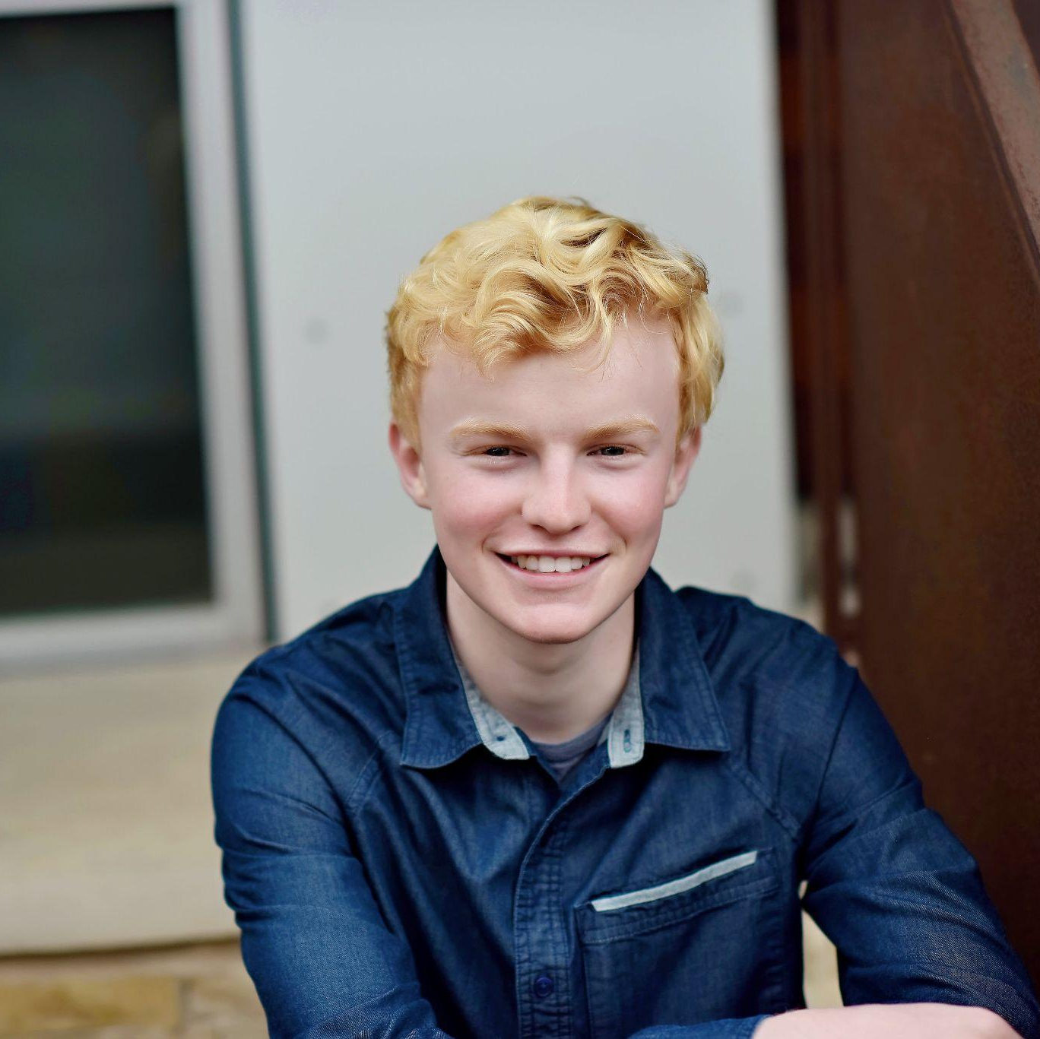
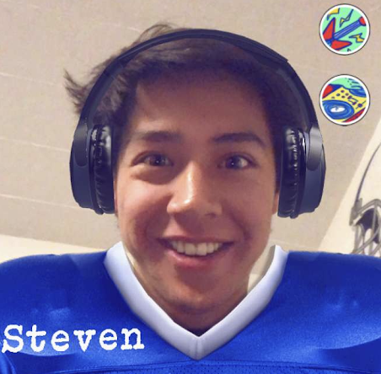
Our Team
Sebastian
Connor
Corbin
Steven
Notes:
Our Team

Slide 3

Mission Statement
Value Proposition
Our aim with Wavelength is make it easier for people with similar music tastes to connect. We believe music is better when you share it with others!
Connecting compatible music listeners.

Slide 4
Problem/Solution Overview
It can be difficult to find friends with the same taste in music. There is a vast pool of musical genres and artists, AND growing number of ways to consume music.
Our solution, Wavelength, is a platform where users are matched with one another based on sampled music taste and geographical proximity. We encourage users to chat about their music taste, share songs with each other, or even meet in real life and go to a concert together.

Slide 5
Overview
Heuristic Evaluation Results
Key Violations to Address
Revised UI Design
Current Prototype Progress
Prototype Demo

Slide 6
Heuristic Evaluation Results

Slide 7
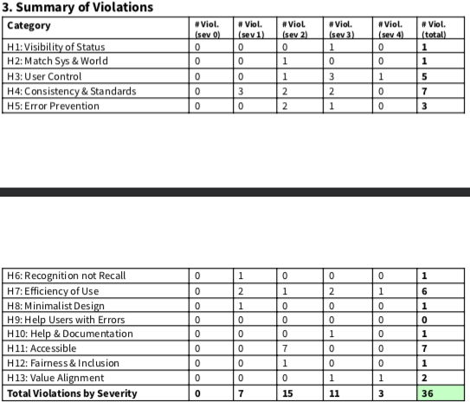
Important Results and Takeaways
Make user navigation more intuitive
Add settings and notifications
Prevent errors in the domain of playlists and song selection
Refine usability without altering core motivations

Slide 8
Violations Addressed
H1: Lack of Notifications (sev 3)
Solution: Added notification icon to ‘friends’ tab, specific chats
H3/H5: cannot edit queue in live listening session (sev 3)
Solution: add edit button to reorder and delete songs
H7: Cannot access friend’s profile from chat page (sev 3)
Solution: link user avatar to their profile page
H3/H7: No settings or ability to delete chat (sev 4)
Solution: Can remove profile, messages in Hi-Fi. Settings added to profile page.

Slide 9
Results Explained
In our Med-Fi prototype, we failed to recognize some significant usability details, particularly including notifications, settings, and certain navigation options. Luckily, these were pointed out by our peers in the heuristic evaluations, and comprise some relatively easy fixes. Going into our Hi-Fi, we will be sure to implement these changes.

Slide 10
Revised UI Design

Slide 11
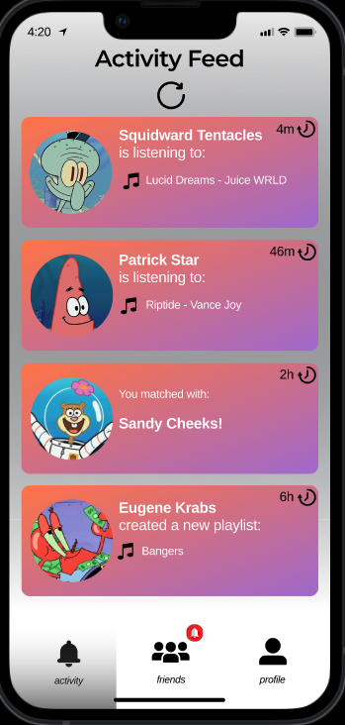
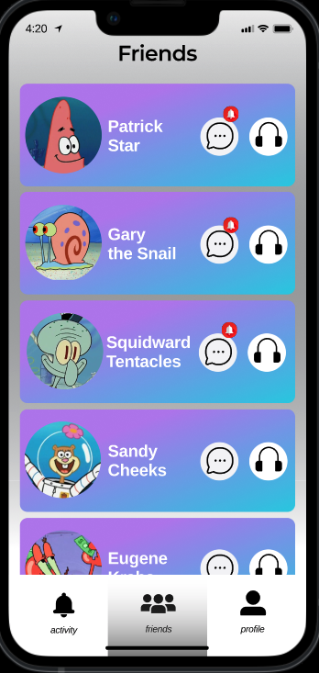
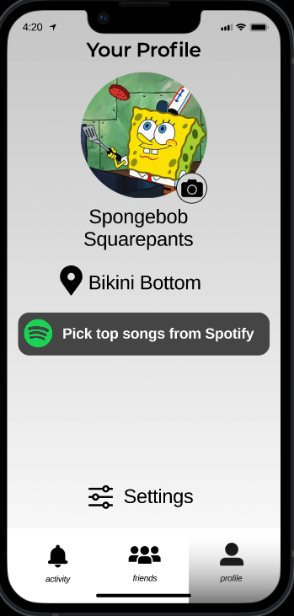
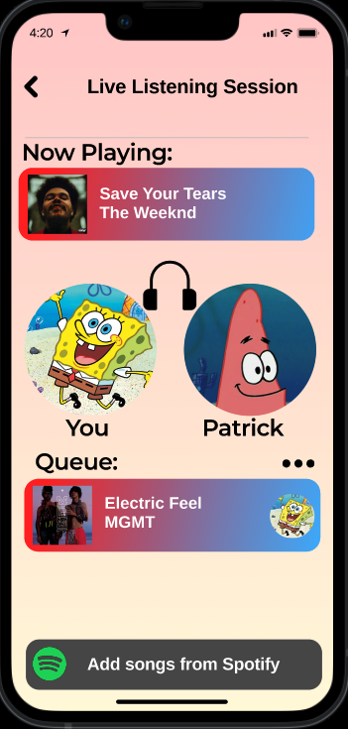
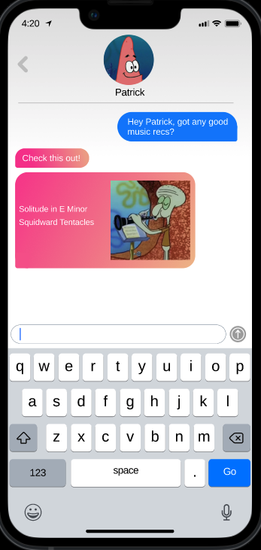
Revisions based on HE results
Chat notification icon added
Clicking avatar now takes you to Patrick’s profile
Notification icon added to friends tab if you have unopened chats.
Settings button added to profile screen
Edit button added to queue

Slide 12
Novel Interface
We strove to bridge the gap between interaction and personalization in our interface. Our app is visually simple, with a strong emphasis on friends and listening activity as shown by the main pages.

Slide 13
Prototype

Slide 14


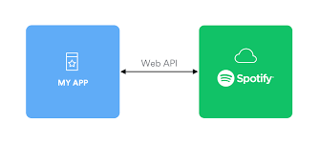
Tools Utilized
Built in ReactNative with Expo
Utilizes Spotify API
For OAuth user authentication
For spotify user data
Used MongoDB, Express and NodeJS for backend

Slide 15
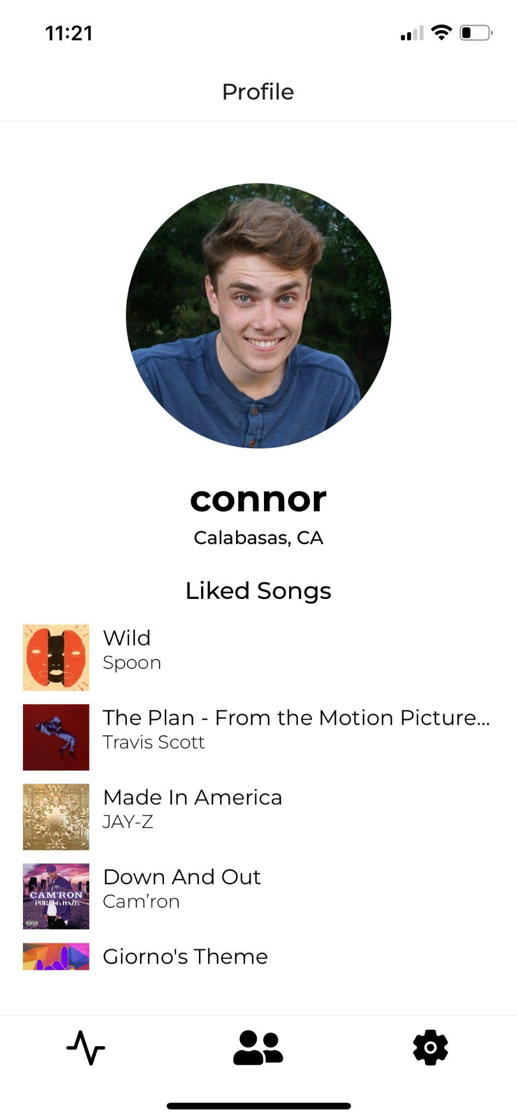
Implementation: So Far
Implementation of Task 1: Create a user account and customize your profile through linking your spotify account
Can connect spotify
Liked songs automatically displayed
User picture taken from spotify
Can add location

Slide 16
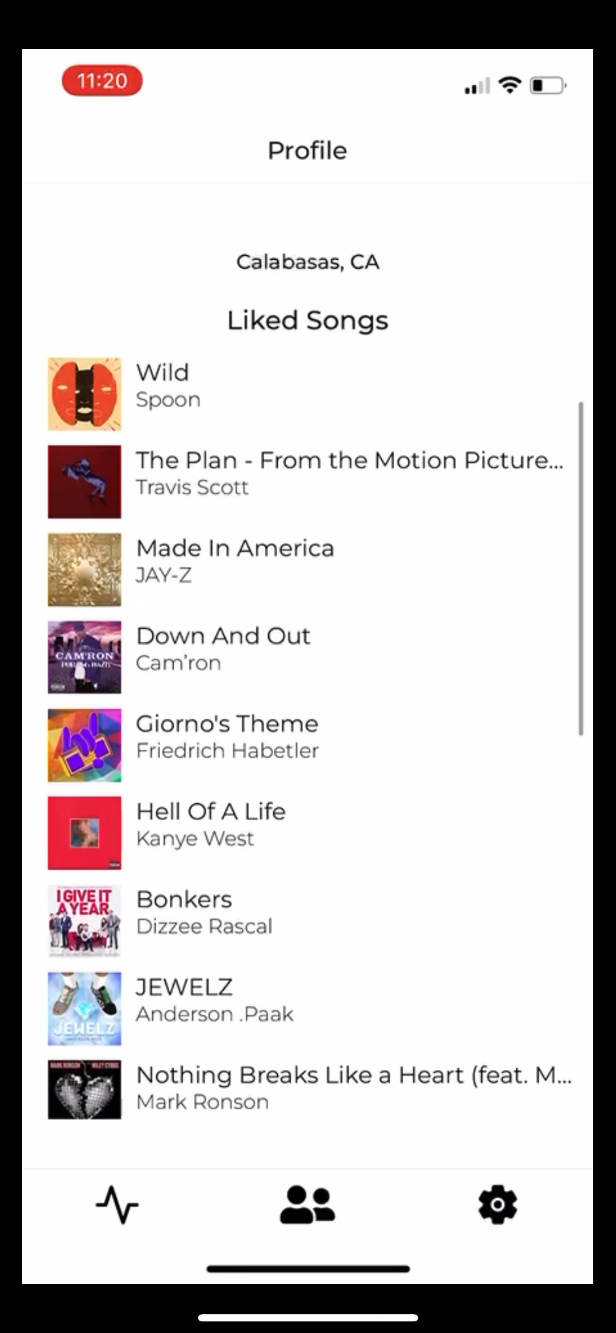
Implementation: Next Steps
Connect matches with each other
View friend profiles
Add chat functionality
Create live listening session functionality

Slide 17
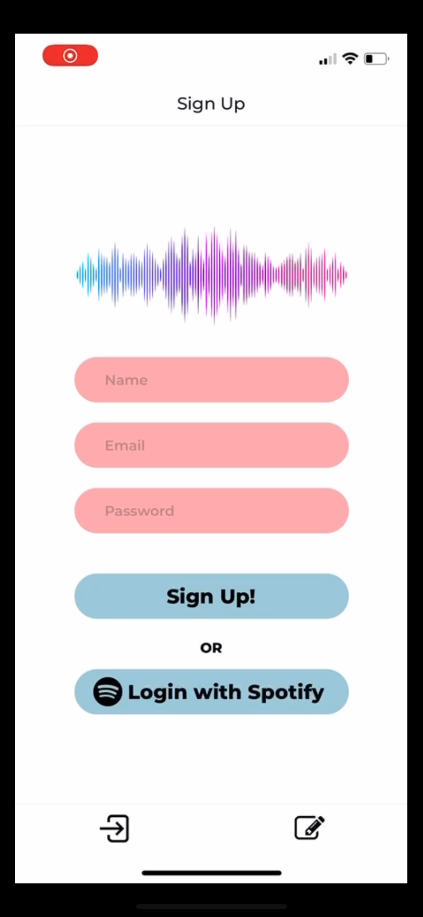
Prototype Design and Standards
Used figma design components as backbone of development
Applied a simple, clean look and feel with a lot of whitespace
Made navigation comprehensive and seamless

Slide 18
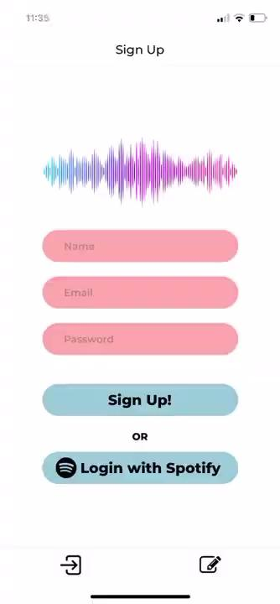
Completed Task Demonstration
Automatically creating your account with Spotify and viewing your profile

Slide 19
Summary
Using our Med-Fi prototype as a building block, we incorporated feedback from the heuristic evaluation exercise to correct usability mistakes and begin constructing an engaging Hi-Fi prototype. We have implemented our first task, creating a profile, and are on the way to constructing the rest of the functionality of Wavelength.
“Connecting compatible music listeners”

Slide 20
Thank You!

